Slide 1
BUAN 6312 - Applied Econometrics and Time Series Analysis
Group 3 Project
Presented By –
Anmol Dwivedi (Leader),
Mohitha Suresh Singh,
Ajitesh Goswami,
Viraja Nelagi,
Manish Surabhi,
Varun Verma,
Yojitha Naga Vaibhavi Uppala,
Shreya Reddy Mranganti.

Slide 2
Research Project Topic
Examining the Impact of the Russia-Ukraine
War on Key Economic Indicators in the US
Research Question
Do the COVID-19 pandemic and the Russia-Ukraine conflict
have measurable impacts on key US economic indicators

Slide 3
Agenda
Title
Research Topic and Question
Motivation
Literature Review
Data Collection Strategy
Data Pre-Preprocessing
Exploratory Data Analysis (EDA)
Stationarity Analysis
Modeling Approach
Model Diagnostics
Results
Conclusion and Future Work

Slide 4



Research Motivation
Importance of Understanding Geopolitical Shock Effects
Geopolitical
Shock
Analysis
The ongoing conflict introduces volatility in energy prices, which can ripple through various economic sectors.
Contextual Economic Disruptions
To evaluate the resilience of the U.S. economy during periods of global uncertainty, helping to identify areas of vulnerability and strength in its economic framework.
Need for
Data-Driven
Insights
Informed policy decisions necessitate empirical evidence that highlights vulnerabilities within the economy in response to external shocks.
Numbers DO NOT LIE!!

Slide 5
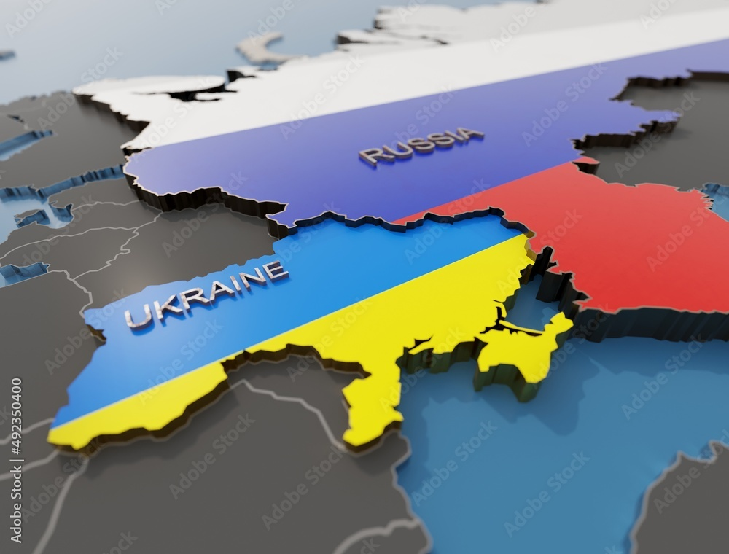
Research Motivation
Research Question: Our study poses an inquiry into the econometric evidence surrounding the influence of the COVID-19 pandemic and the Russia-Ukraine conflict on critical economic parameters in the US.
Methodology: Utilizing Vector Autoregression with Exogenous Variables (VARX) modeling, we aim to systematically evaluate the impacts of these unprecedented events on key economic indicators such as inflation, unemployment rates, and crude oil prices.
Significance: This research addresses a crucial question in economic policy-making, by understanding how geopolitical conflicts and pandemics shape macroeconomic dynamics, thereby informing the strategies that policymakers may adopt.

Slide 6

Literature Review
Assessing Economic Resilience to Global Shocks
The COVID-19 pandemic and Russia-Ukraine conflict disrupted global supply chains, energy markets, and trade dynamics. These events revealed the vulnerabilities of interconnected economies, particularly in areas like inflation, energy prices, and financial market volatility. Research by the International Monetary Fund (2022) highlights how such crises created inflationary pressures in developed economies, including the United States.
Source: International Monetary Fund. (2022). World Economic Outlook: War Sets Back the Global Recovery. https://www.imf.org/
Financial Market Volatility as an Indicator of Crisis - Global crises often lead to heightened financial market volatility. The Federal Reserve (2023) reported significant market fluctuations due to both the COVID-19 pandemic and geopolitical tensions. This study aims to capture the extent of these changes and their implications for economic stability.
Source: Federal Reserve. (2023). Financial Stability Report. https://www.federalreserve.gov/

Slide 7

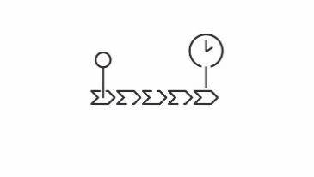





Data Collection and Consolidation
Source
Data Timeline
With 140 observations and 17 variables, our dataset offers a snapshot view for analysis, encompassing various economic dynamics.
Our dataset was collected through reputed publicly available and trusted sources.
For Our Analysis, we have considered data from January’2013 to August’2024 at a Monthly Frequency.
Specifications

Slide 8
Economic Variables - Data Dictionary

Slide 9



Data Pre-Processing
Cleaning Process
Ensuring Stationarity
Tools Used
We trimmed the data down and considered monthly data from Jan’2013 to Aug’2024
Converted Daily Data to Monthly Data
Null Value Check
Covid: 20th Jan’20 – 11th May’23
War: February’2022
Consolidated Dataset
Augmented Dickey Fuller Test (ADF Test)
Kwiatkowski-Phillips-Schmidt-Shin test (KPSS Test)
1st and 2nd Differencing to make the series Stationary
Python
Pandas
Matplotlib
Seaborn
Statsmodel
Pickle

Slide 10
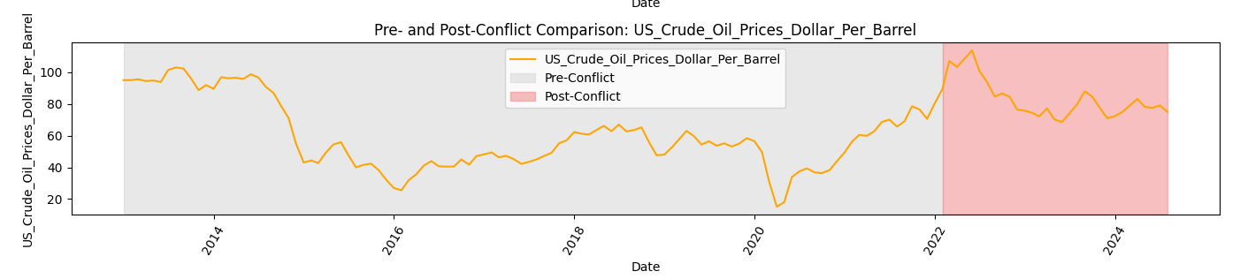
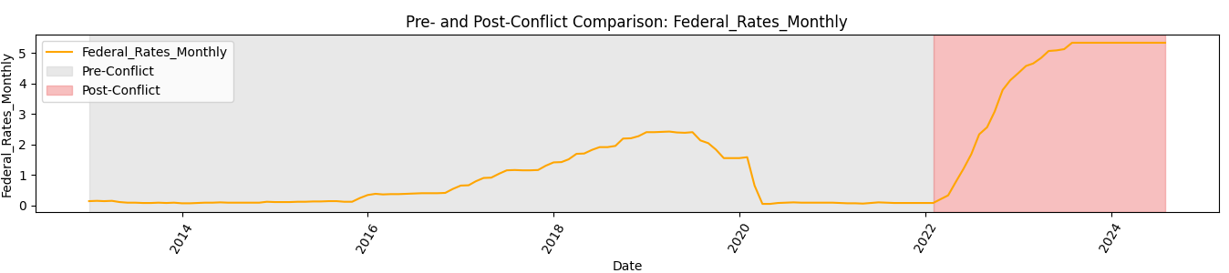
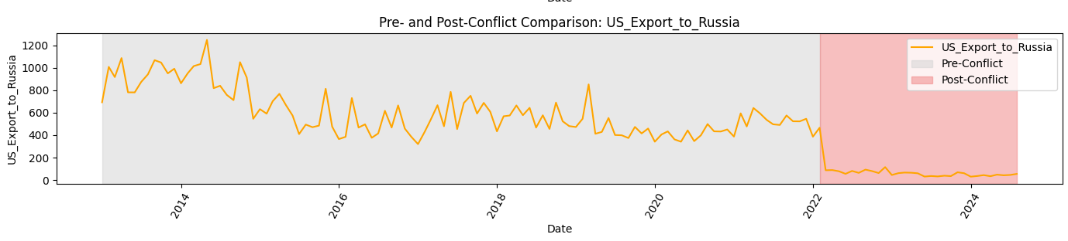
Exploratory Data Analysis : Important Highlights
Significant fluctuations are visible post-2022, which aligns with the onset of the Russia-Ukraine conflict
A sharp increase in federal rates post-2022 is evident, likely in response to inflationary pressures exacerbated by the conflict.
Exports to Russia sharply decline to near zero post-2022, illustrating the impact of sanctions and strained trade relations following the conflict.

Slide 11
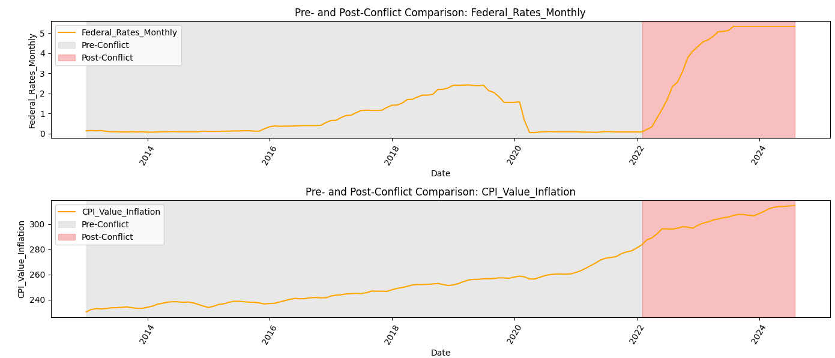
Exploratory Data Analysis : Important Highlights
A sharp increase in federal rates post-2022 is evident, likely in response to inflationary pressures exacerbated by the conflict.
The continuous rise in CPI post-2020 (COVID-19) and a further surge post-2022 indicates inflationary trends influenced by the pandemic and geopolitical tensions,

Slide 12
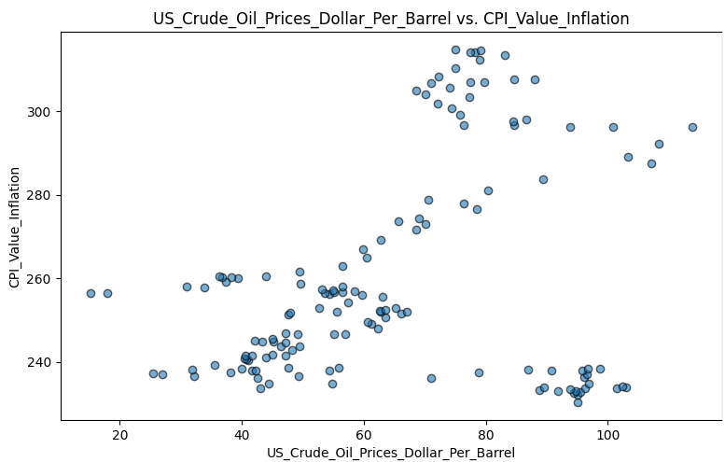
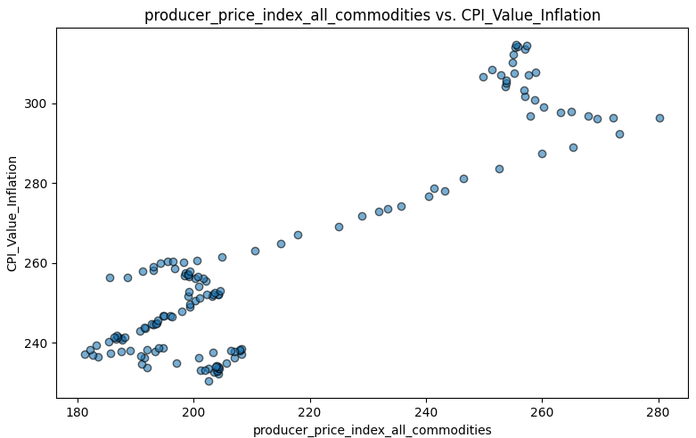
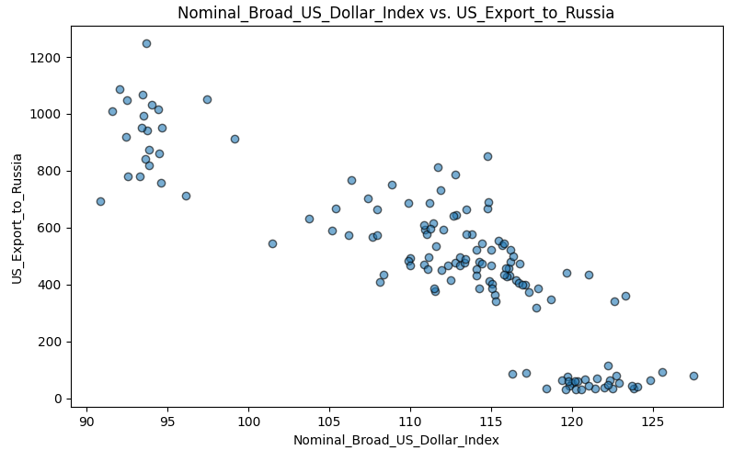
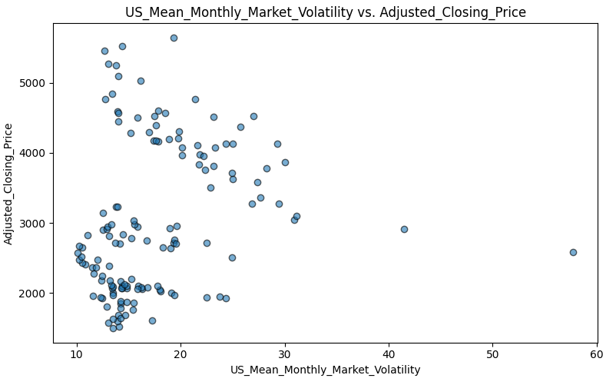
Exploratory Data Analysis : Important Highlights

Slide 13
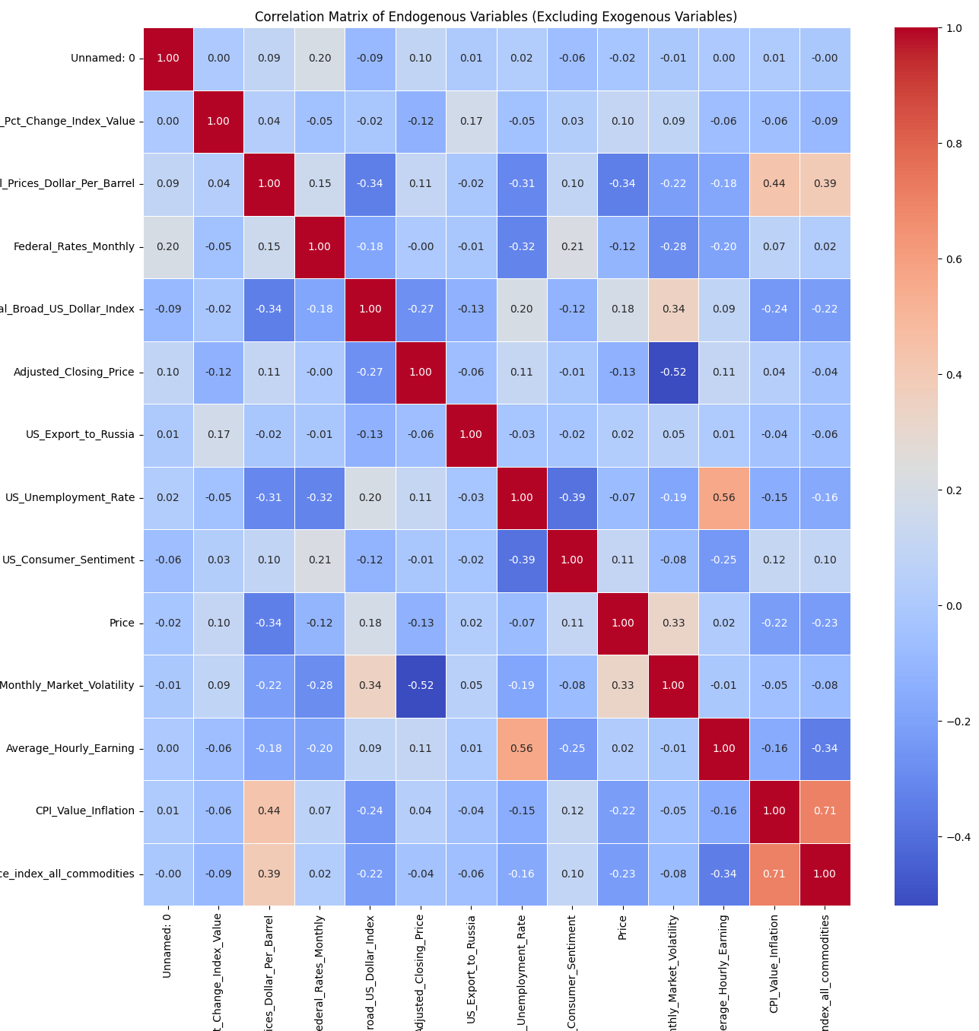
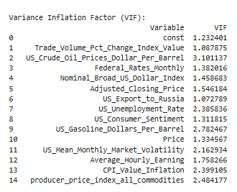
Correlation Analysis of Data (Post Making the Time Series Stationary)
After making the data stationary, correlation analysis helps identify the relationships between variables by removing trends and seasonality. This ensures that the analysis focuses on the true underlying dynamics rather than spurious correlations caused by non-stationary data.
Strongest Positive Correlation - Producer Price Index (PPI) and CPI Value Inflation (0.71)
Strongest Negative Correlation - Adjusted Closing Price and Market Volatility (-0.52)

Slide 14
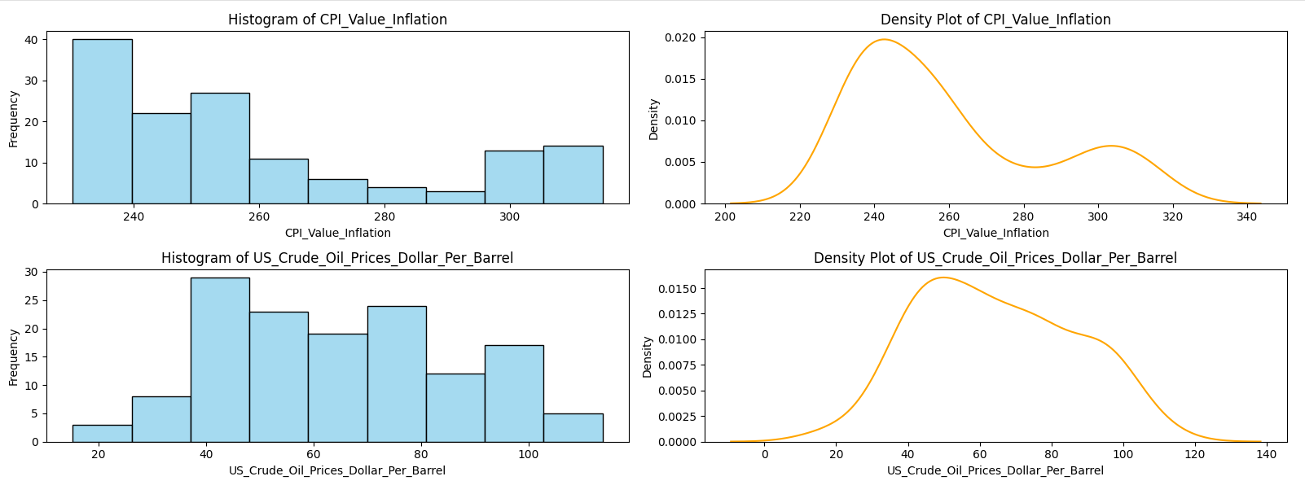
Exploratory Data Analysis : Important Highlights
CPI Value Inflation- Inflation is a critical economic indicator directly affected by global events like the COVID-19 pandemic and the Russia-Ukraine conflict. This plot provides an insight into the distribution of inflation over the observed timeline, reflecting the economic pressures during crises.
US Crude Oil Prices (Dollar per Barrel) - Crude oil prices are highly sensitive to geopolitical events, especially the Russia-Ukraine conflict, which disrupted global energy supply. This plot highlights how crude oil prices behaved during this period, offering an understanding of the broader economic implications.

Slide 15
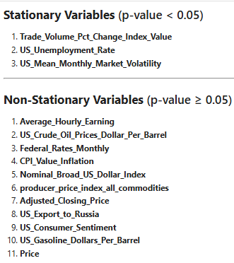
Stationarity Analysis : Meeting the VARX Requirements
ADF Test
First Differencing
ADF Test
KPSS Test
KPSS Test
Second Differencing
Variables that become Stationary After 1st Differencing:
Average_Hourly_Earning
Federal_Rates_Monthly
CPI_Value_Inflation
Nominal_Broad_US_Dollar_Index
producer_price_index_all_commodities
Variables that become Stationary After 2nd Differencing:
Average_Hourly_Earning', 'CPI_Value_Inflation', 'producer_price_index_all_commodities

Slide 16
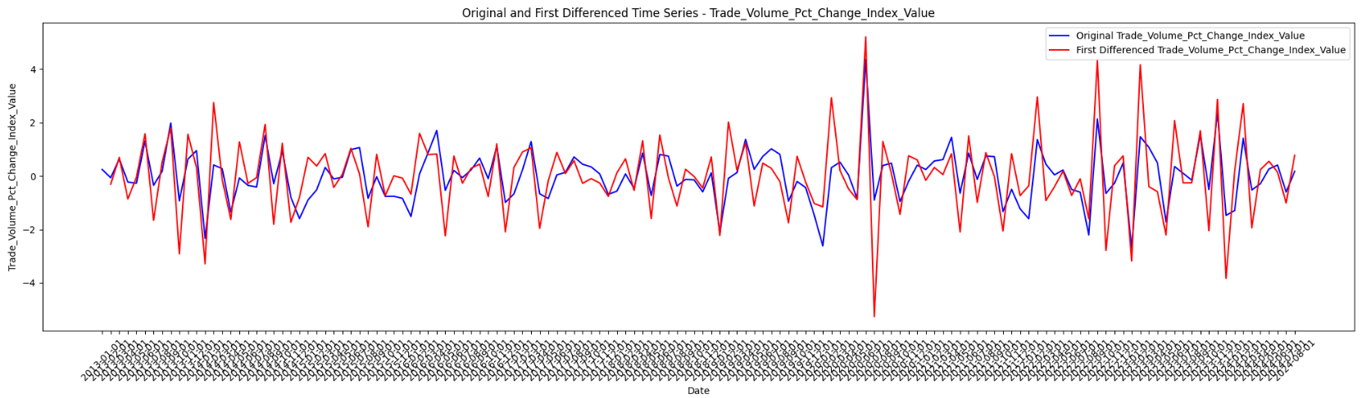
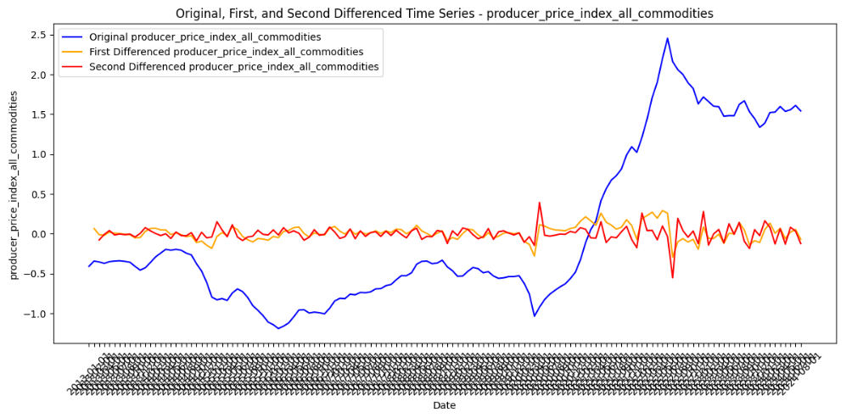
Stationarity Analysis : Meeting the VARX Requirements

Slide 17
VARX Modelling : Why this Model??
A VARX (Vector Autoregression with Exogenous Variables) model is a statistical tool used to analyze the relationships between multiple interdependent variables over time, while also considering the effects of external factors or events. It helps us understand how variables influence each other dynamically and how external events, like the COVID-19 pandemic or the Russia-Ukraine conflict, impact the system. This makes it ideal for studying complex economic systems.
Captures the dynamic interdependencies between multiple economic indicators, offering a comprehensive view of their relationships.
Incorporates exogenous shocks like the COVID-19 pandemic and the Russia-Ukraine conflict, directly assessing their impacts.
Effectively models lagged relationships, addressing the delayed effects often seen in economic variables.
Provides robust and interpretable insights compared to machine learning models, aligning with econometric best practices.
Overcomes the limitations of univariate models like ARIMA, which cannot handle multiple interdependent variables or external events.
Regression vs. VARX: Regression models assume a unidirectional relationship (independent vs. dependent variables), while VARX captures bidirectional influences and feedback among multiple variables over time.
ARIMA vs. VARX: ARIMA focuses on univariate forecasting and does not handle multiple interrelated time series, whereas VARX models are specifically designed for multivariate systems.
Exogenous Variables: VARX integrates external events (like the Russia-Ukraine conflict and COVID-19) into the analysis, which traditional time series models like ARIMA cannot do effectively.

Slide 18
Stationarity Analysis : Meeting the VARX Requirements
General Hypothesis:
H₀: The Russia-Ukraine war (as captured by the exogenous variable Russia_Ukraine_Date_Flag) has no significant impact on key U.S. economic indicators.
H₁: The Russia-Ukraine war has a significant impact on key U.S. economic indicators.
Covid Flag (Exogeneous Control)
H₀: The COVID-19 pandemic has no additional impact on U.S. economic indicators, independent of the Russia-Ukraine war.
H₁: The COVID-19 pandemic has a significant additional impact on U.S. economic indicators, independent of the Russia-Ukraine war.

Slide 19
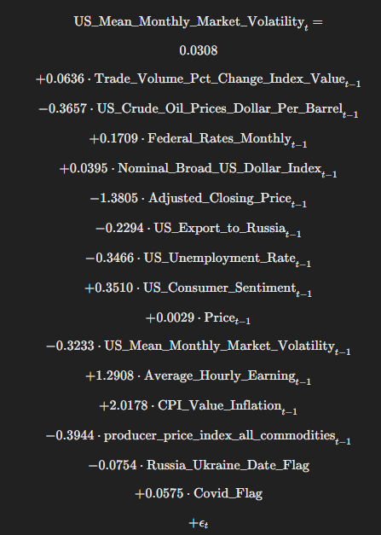
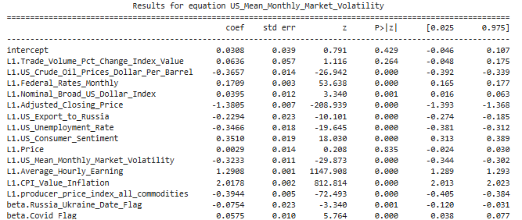
Understanding the VARX Model Outputs
The VARX model outputs a regression-like summary for each variable because it models a system of equations where each variable is treated as a dependent variable in its own equation.
Market Volatility Variable
p>0.05 - Insignificant
P<=0.05 - Significant

Slide 20
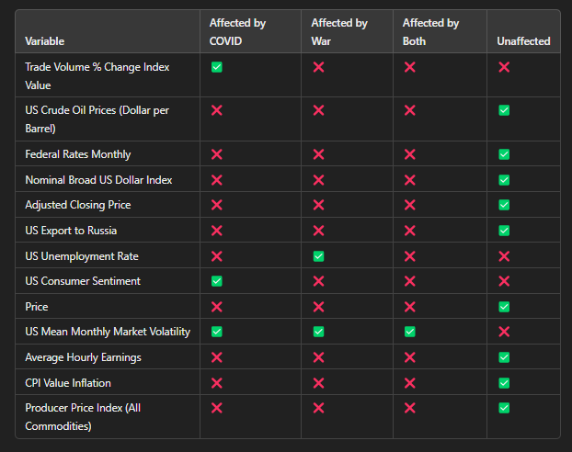
VARX Model Results

Slide 21
VARX Model Results with Real World Happenings

Slide 22
Thank You

